Slide 1
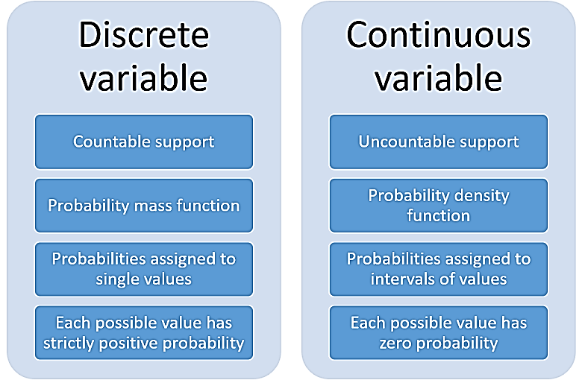
Chapter: 07 Discrete Probability
7.1 An Introduction to Discrete Probability
FREE: For Complete Playlist: https://www.youtube.com/c/FahadHussaintutorial/playlists
For Code, Slide and Books: https://fahadhussaincs.blogspot.com/

Slide 2
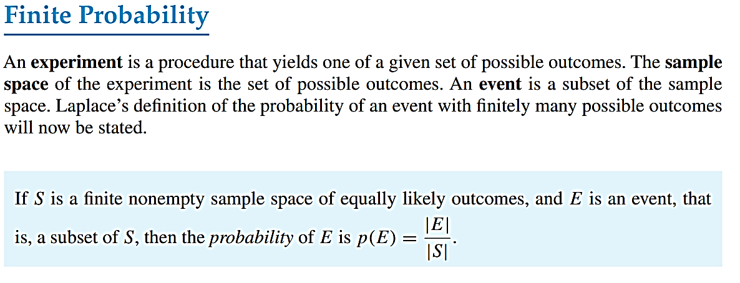
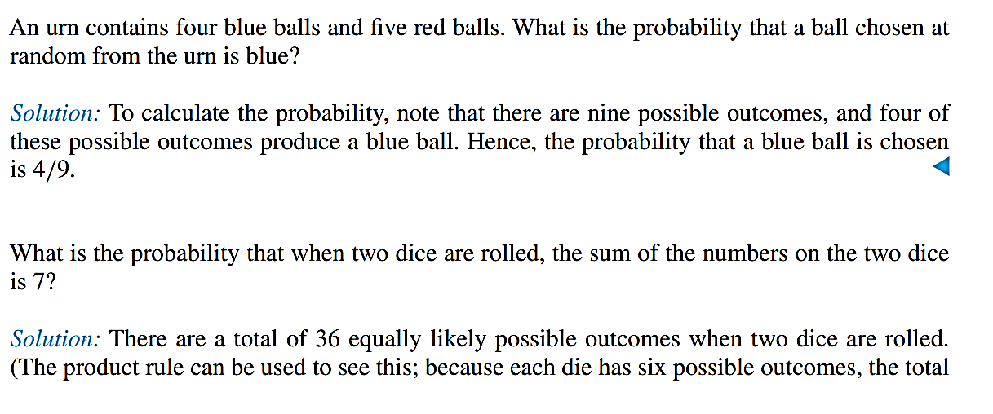
FREE: For Complete Playlist: https://www.youtube.com/c/FahadHussaintutorial/playlists
For Code, Slide and Books: https://fahadhussaincs.blogspot.com/

Slide 3
Probability Rules
P(S) = 1
0 <= P(A) <= 1
P(A') = 1 - P(A)
P(at least 1) = 1 P(none)
P(A∪B) = P(A) + P(B) − P(A∩B)
P(A∩B) = P(A) . P(B|A)
FREE: For Complete Playlist: https://www.youtube.com/c/FahadHussaintutorial/playlists
For Code, Slide and Books: https://fahadhussaincs.blogspot.com/

Slide 4
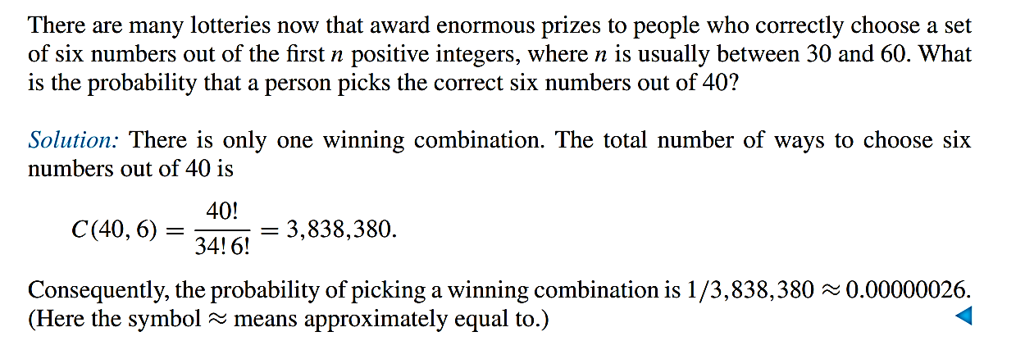
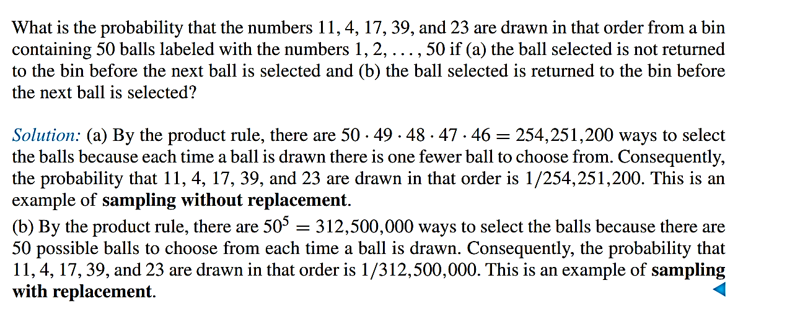
FREE: For Complete Playlist: https://www.youtube.com/c/FahadHussaintutorial/playlists
For Code, Slide and Books: https://fahadhussaincs.blogspot.com/

Slide 5
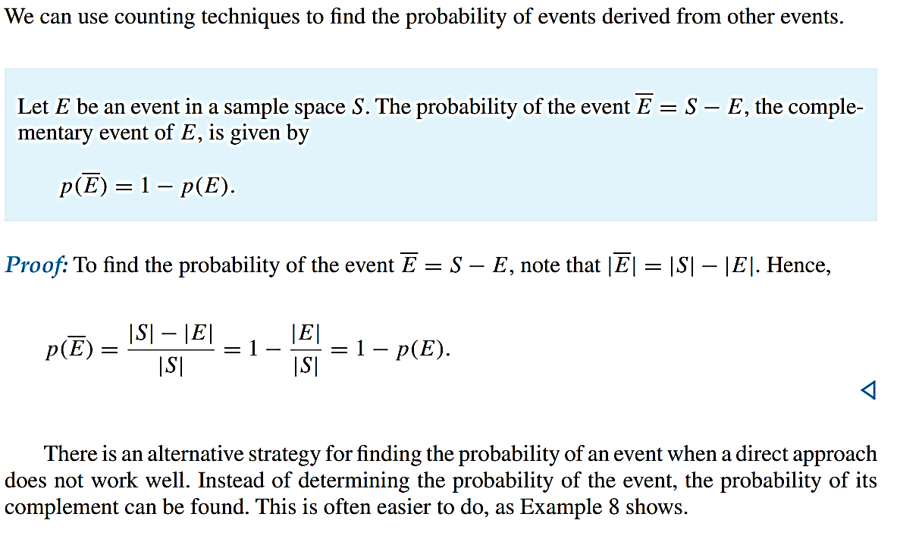
Probabilities of Complements and Unions of Events
FREE: For Complete Playlist: https://www.youtube.com/c/FahadHussaintutorial/playlists
For Code, Slide and Books: https://fahadhussaincs.blogspot.com/

Slide 6
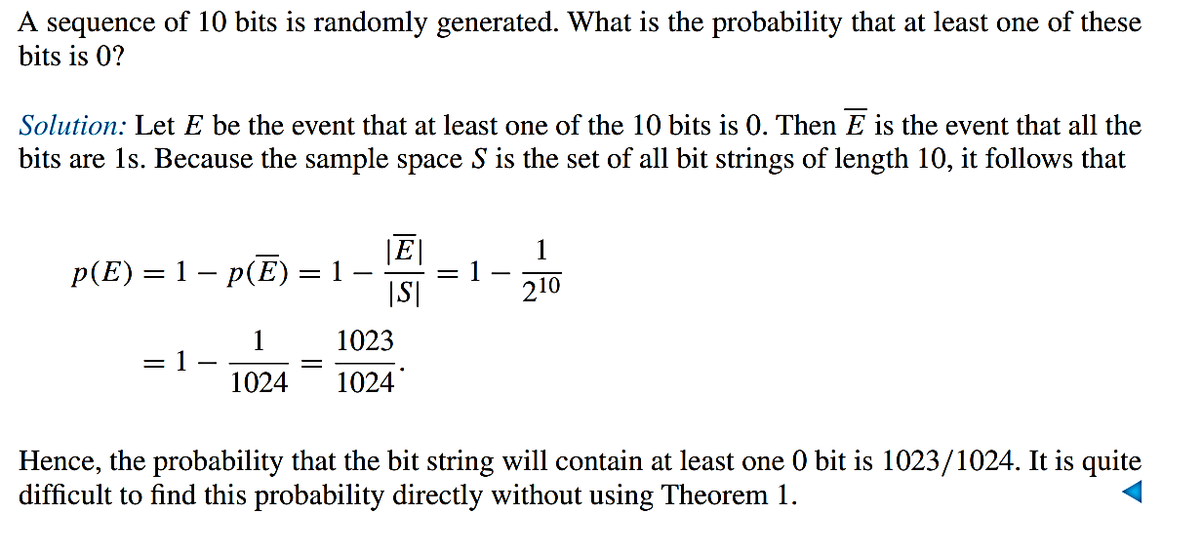
Probabilities of Complements and Unions of Events
FREE: For Complete Playlist: https://www.youtube.com/c/FahadHussaintutorial/playlists
For Code, Slide and Books: https://fahadhussaincs.blogspot.com/

Slide 7
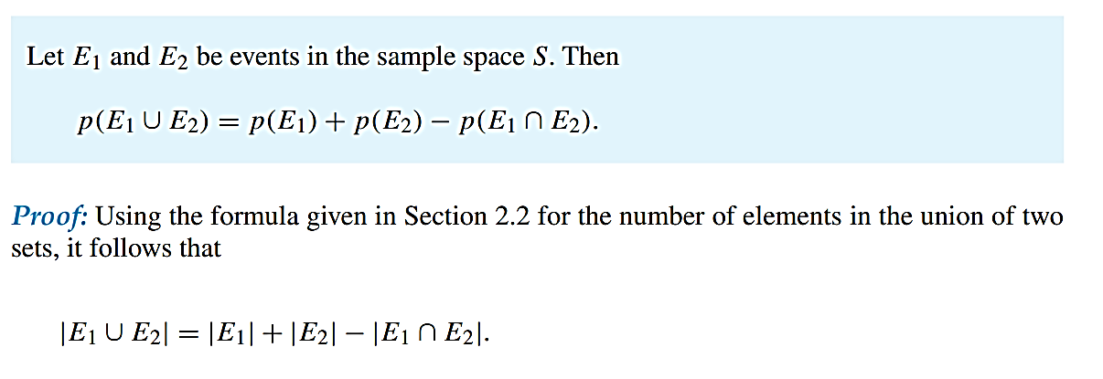
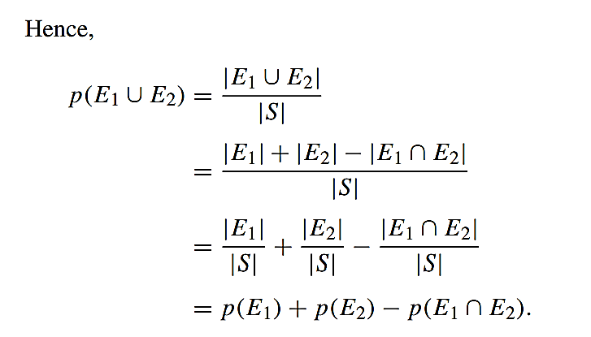
Probabilities of Complements and Unions of Events
We can also find the probability of the union of two events.
FREE: For Complete Playlist: https://www.youtube.com/c/FahadHussaintutorial/playlists
For Code, Slide and Books: https://fahadhussaincs.blogspot.com/

Slide 8
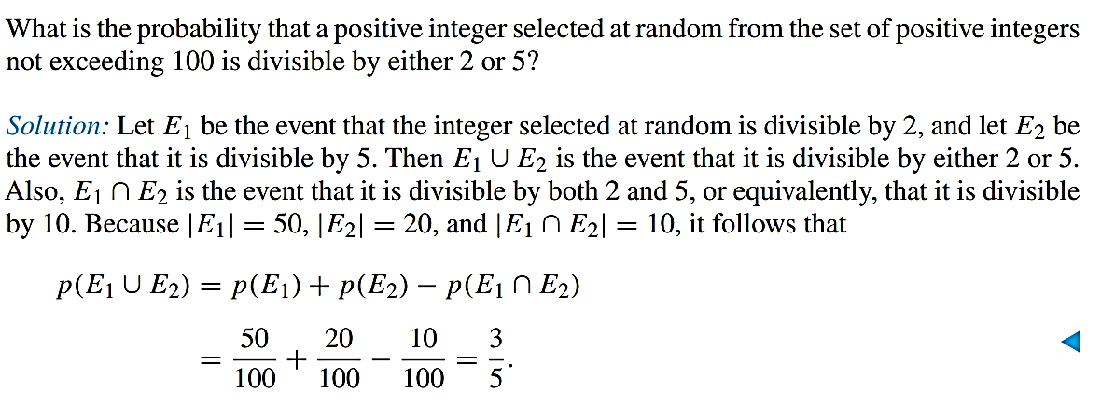
Probabilities of Complements and Unions of Events
FREE: For Complete Playlist: https://www.youtube.com/c/FahadHussaintutorial/playlists
For Code, Slide and Books: https://fahadhussaincs.blogspot.com/

Slide 9
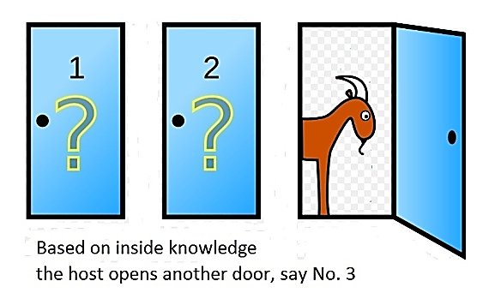
Probabilistic Reasoning
The Monty Hall Three-Door Puzzle
FREE: For Complete Playlist: https://www.youtube.com/c/FahadHussaintutorial/playlists
For Code, Slide and Books: https://fahadhussaincs.blogspot.com/

Slide 10
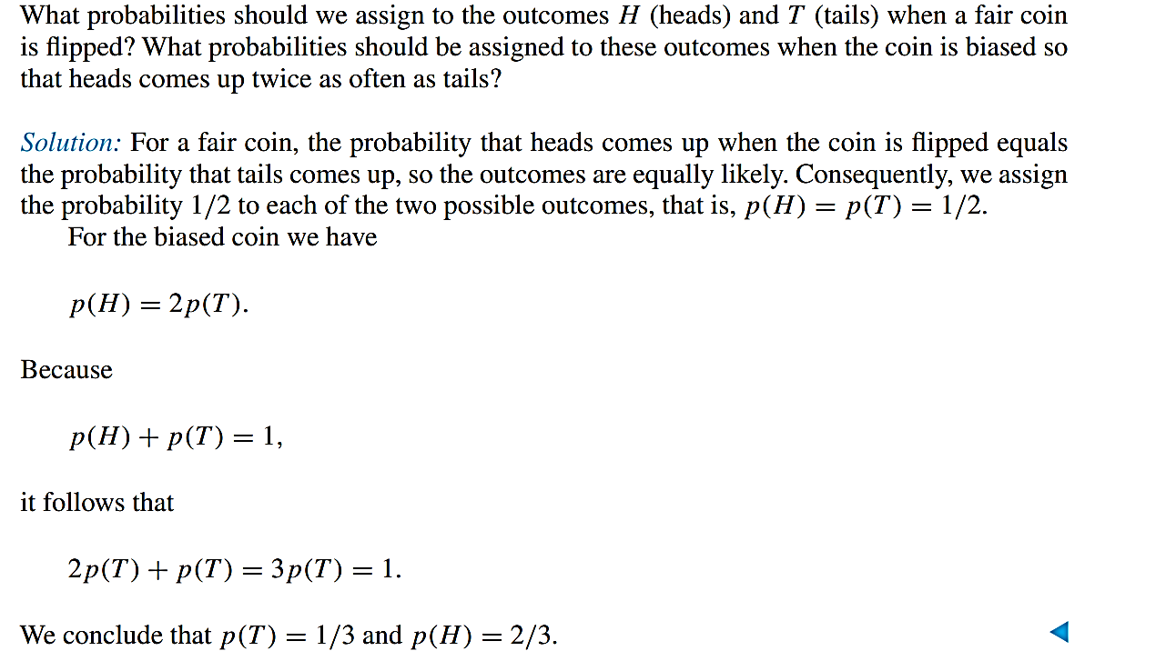
Chapter: 07 Discrete Probability
7.2 Probability Theory
Assigning Probabilities
FREE: For Complete Playlist: https://www.youtube.com/c/FahadHussaintutorial/playlists
For Code, Slide and Books: https://fahadhussaincs.blogspot.com/

Slide 11
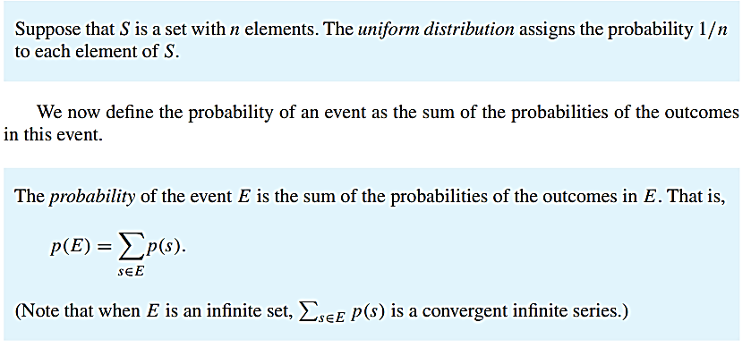
Chapter: 07 Discrete Probability
FREE: For Complete Playlist: https://www.youtube.com/c/FahadHussaintutorial/playlists
For Code, Slide and Books: https://fahadhussaincs.blogspot.com/

Slide 12
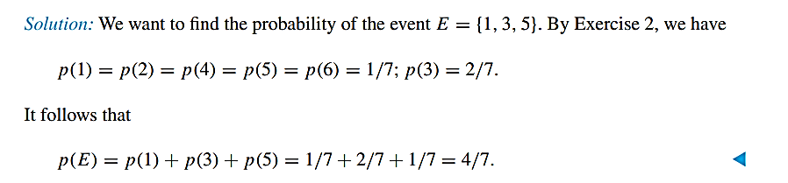
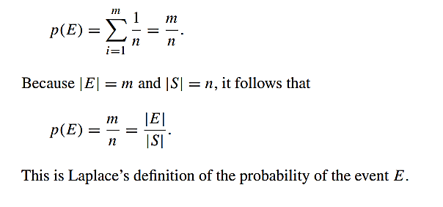
Chapter: 07 Discrete Probability
Suppose that a die is biased (or loaded) so that 3 appears twice as often as each other number but that the other five outcomes are equally likely. What is the probability that an odd number appears when we roll this die?
FREE: For Complete Playlist: https://www.youtube.com/c/FahadHussaintutorial/playlists
For Code, Slide and Books: https://fahadhussaincs.blogspot.com/

Slide 13
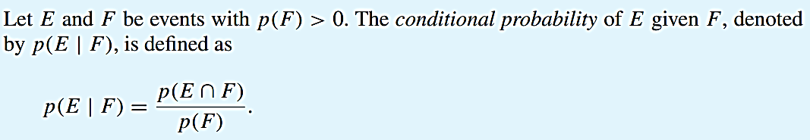
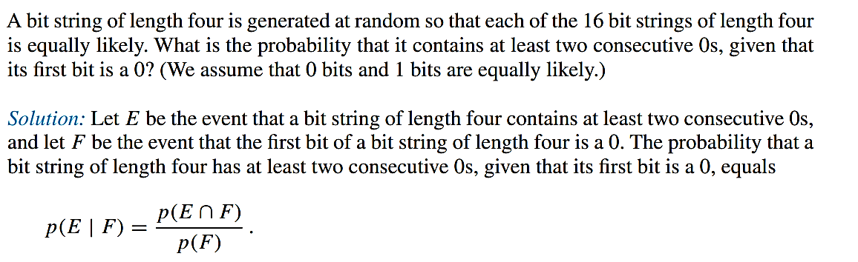
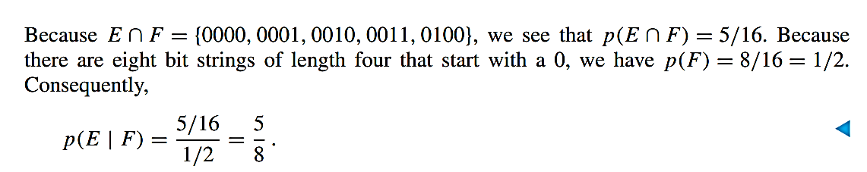
Conditional Probability

Slide 14
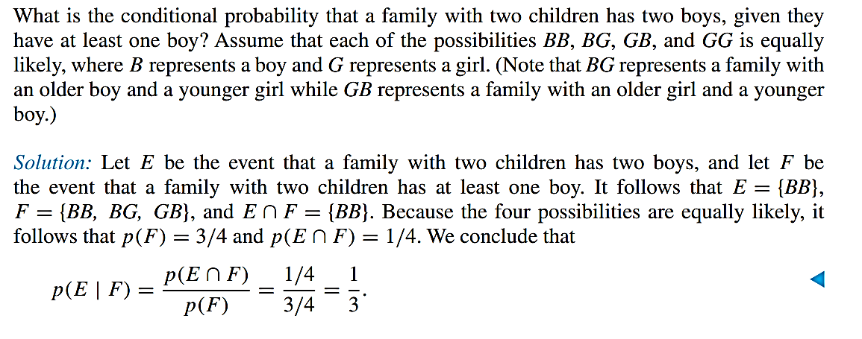
Conditional Probability
FREE: For Complete Playlist: https://www.youtube.com/c/FahadHussaintutorial/playlists
For Code, Slide and Books: https://fahadhussaincs.blogspot.com/

Slide 15
Independence
Suppose a coin is flipped three times, as described in the introduction to our discussion of conditional probability. Does knowing that the first flip comes up tails (event F) alter the probability that tails comes up an odd number of times (event E)? In other words, is it the case that p(E | F ) = p(E)? This equality is valid for the events E and F, because p(E | F ) = 1/2 and p(E) = 1/2. Because this equality holds, we say that E and F are independent events. When two events are independent, the occurrence of one of the events gives no information about the probability that the other event occurs.
Because p(E | F ) = p(E ∩ F )/p(F ), asking whether p(E | F ) = p(E) is the same as asking whether p(E ∩ F ) = p(E)p(F ). This leads to Definition 4.
The events E and F are independent if and only if p(E ∩ F ) = p(E)p(F ).
FREE: For Complete Playlist: https://www.youtube.com/c/FahadHussaintutorial/playlists
For Code, Slide and Books: https://fahadhussaincs.blogspot.com/

Slide 16
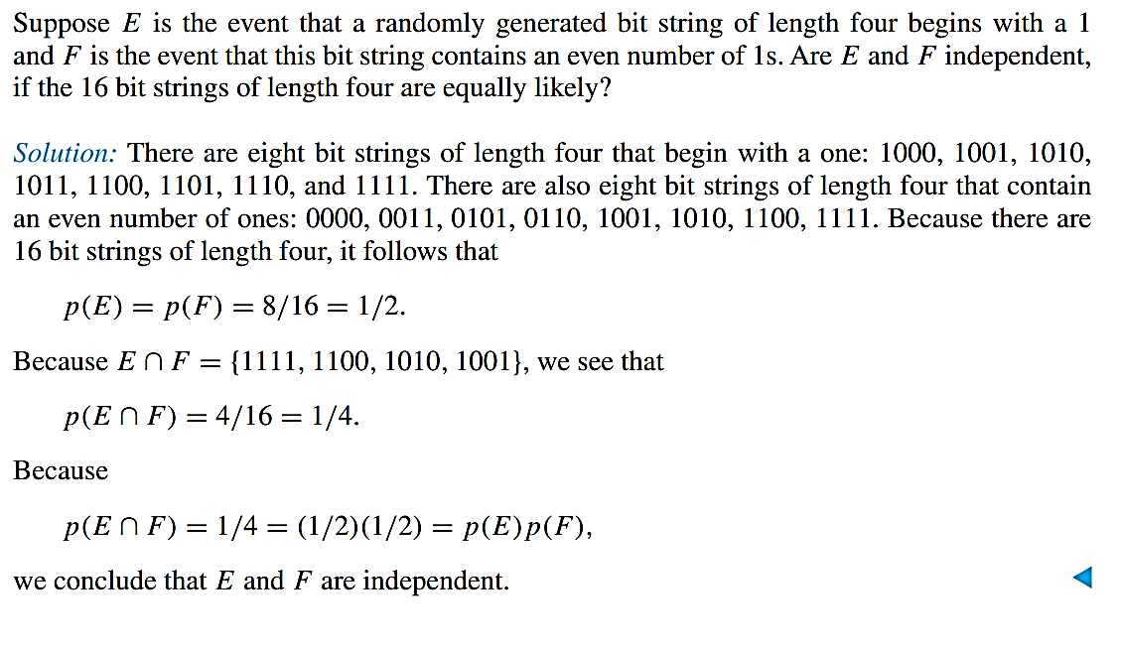
Independence
FREE: For Complete Playlist: https://www.youtube.com/c/FahadHussaintutorial/playlists
For Code, Slide and Books: https://fahadhussaincs.blogspot.com/

Slide 17
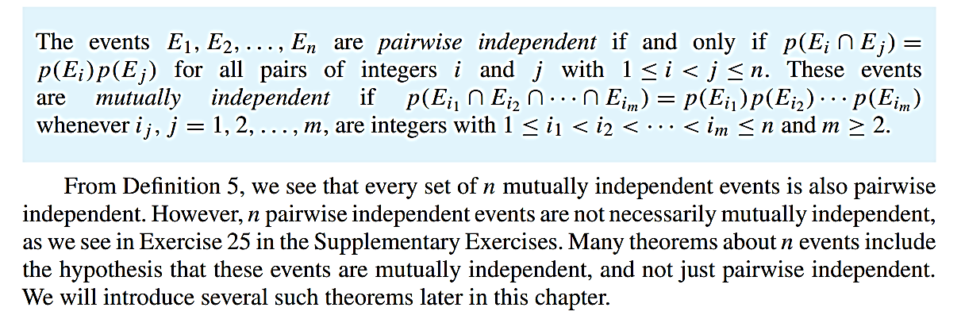
Independence
PAIRWISE AND MUTUAL INDEPENDENCE We can also define the independence of more than two events. However, there are two different types of independence, given in Definition
FREE: For Complete Playlist: https://www.youtube.com/c/FahadHussaintutorial/playlists
For Code, Slide and Books: https://fahadhussaincs.blogspot.com/

Slide 18
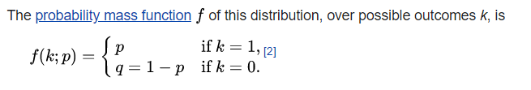
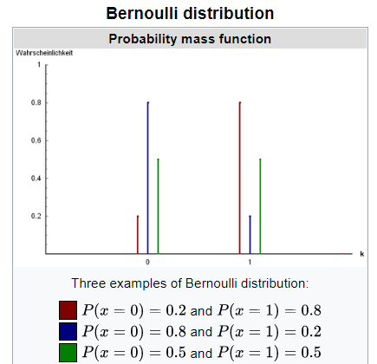

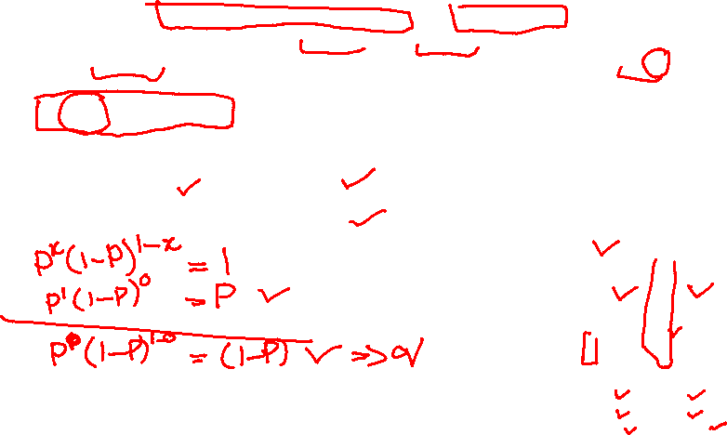
Bernoulli distribution
A Bernoulli distribution is a discrete probability distribution for a Bernoulli trial — a random experiment that has only two outcomes (usually called a “Success” or a “Failure”). For example, the probability of getting a heads (a “success”) while flipping a coin is 0.5. The probability of “failure” is 1 – P (1 minus the probability of success, which also equals 0.5 for a coin toss). It is a special case of the binomial distribution for n = 1. In other words, it is a binomial distribution with a single trial (e.g. a single coin toss).

Slide 19

Bernoulli distribution
A Bernoulli trial is one of the simplest experiments you can conduct. It’s an experiment where you can have one of two possible outcomes. For example, “Yes” and “No” or “Heads” and “Tails.” A few examples:
Coin tosses: record how many coins land heads up and how many land tails up.
Births: how many boys are born and how many girls are born each day.
Rolling Dice: the probability of a roll of two die resulting in a double six.
What are the 3 conditions for a Bernoulli trial?
The 3 conditions for a Bernoulli trial are:
1. Each trial has only two possible outcomes: True/False, Yes/No, Success/Failure, etc.
2. The trials are independent. They do not influence each other.
3. The probabilities of success and failure do not change. They remain the same for all trials.

Slide 20
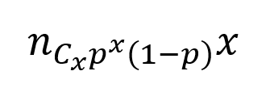
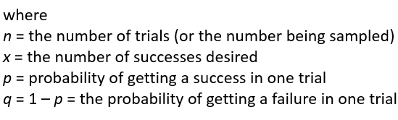
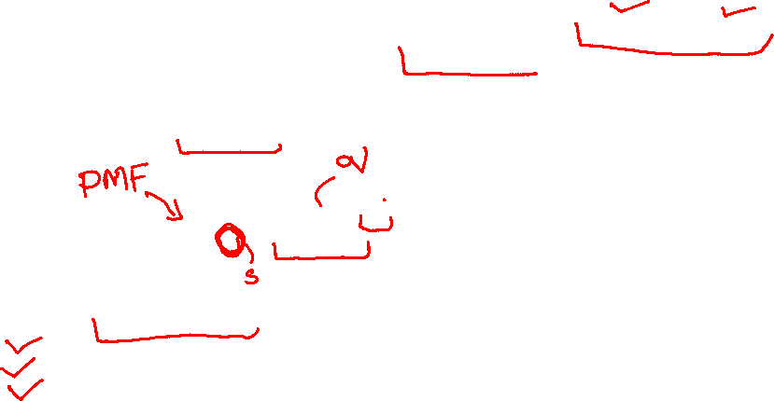
Binomial distribution
A binomial distribution can be thought of as simply the probability of a SUCCESS or FAILURE outcome in an experiment or survey that is repeated multiple times. The binomial is a type of distribution that has two possible outcomes (the prefix “bi” means two, or twice). For example, a coin toss has only two possible outcomes: heads or tails and taking a test could have two possible outcomes: pass or fail.

Slide 21
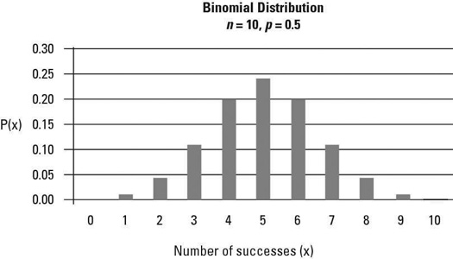
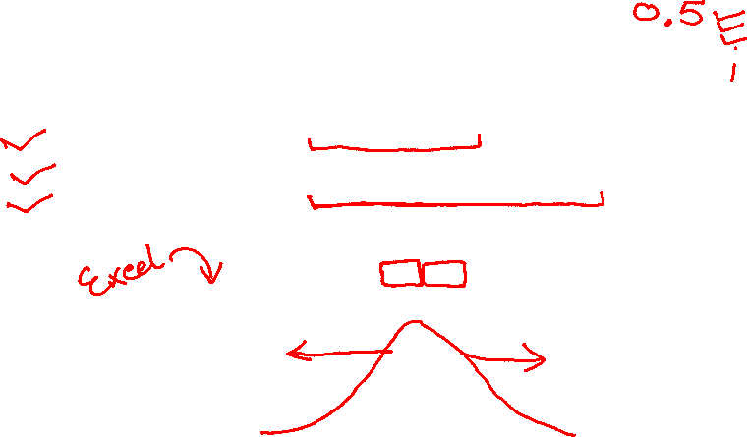
Binomial distribution
A binomial experiment is one that has the following properties:
(1) The experiment consists of n identical trials.
(2) Each trial results in one of the two outcomes, called a success S and failure F.
(3) The probability of success on a single trial is equal to p and remains the same from trial to trial.

Slide 22
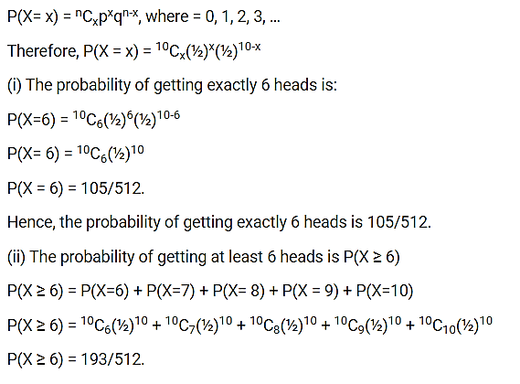
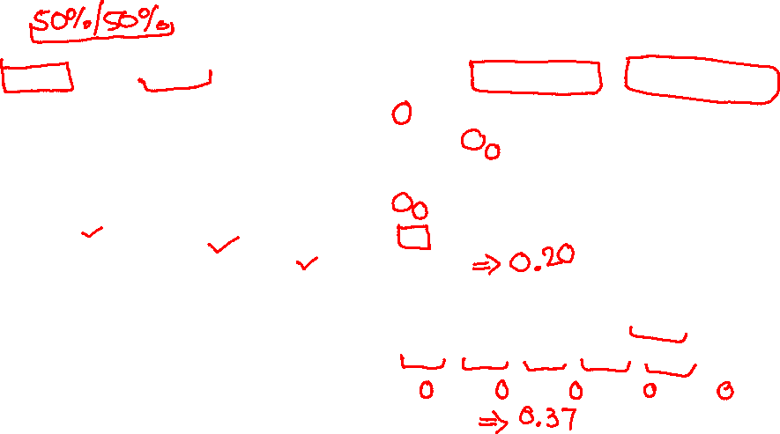
Binomial distribution, Exercise
A fair coin is tossed 10 times, what are the probability of getting exactly 6 heads and at least six heads.
Let x denote the number of heads in an experiment.
Here, the number of times the coin tossed is 10. Hence, n=10.
The probability of getting head, p ½
The probability of getting a tail, q = 1-p = 1-(½) = ½.
The binomial distribution is given by the formula:

Slide 23
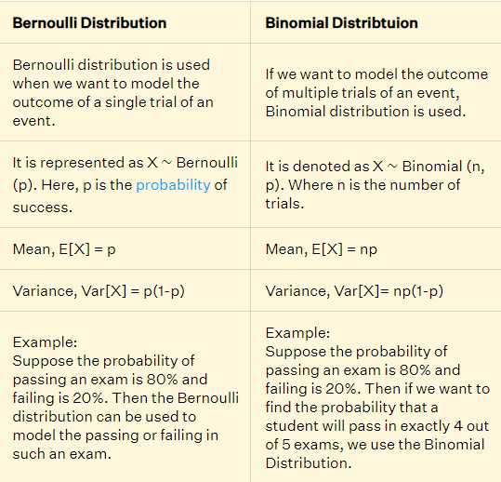
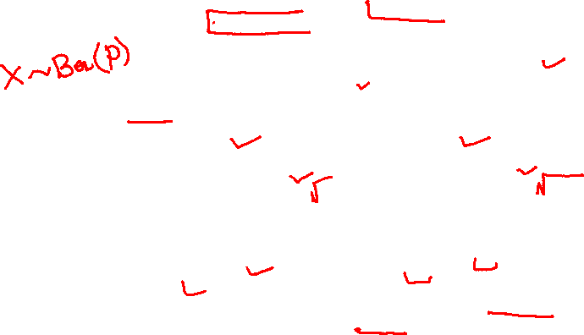

Slide 24
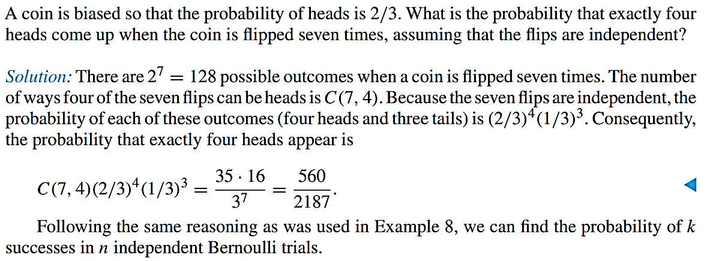
Bernoulli Trials and the Binomial Distribution
FREE: For Complete Playlist: https://www.youtube.com/c/FahadHussaintutorial/playlists
For Code, Slide and Books: https://fahadhussaincs.blogspot.com/

Slide 25
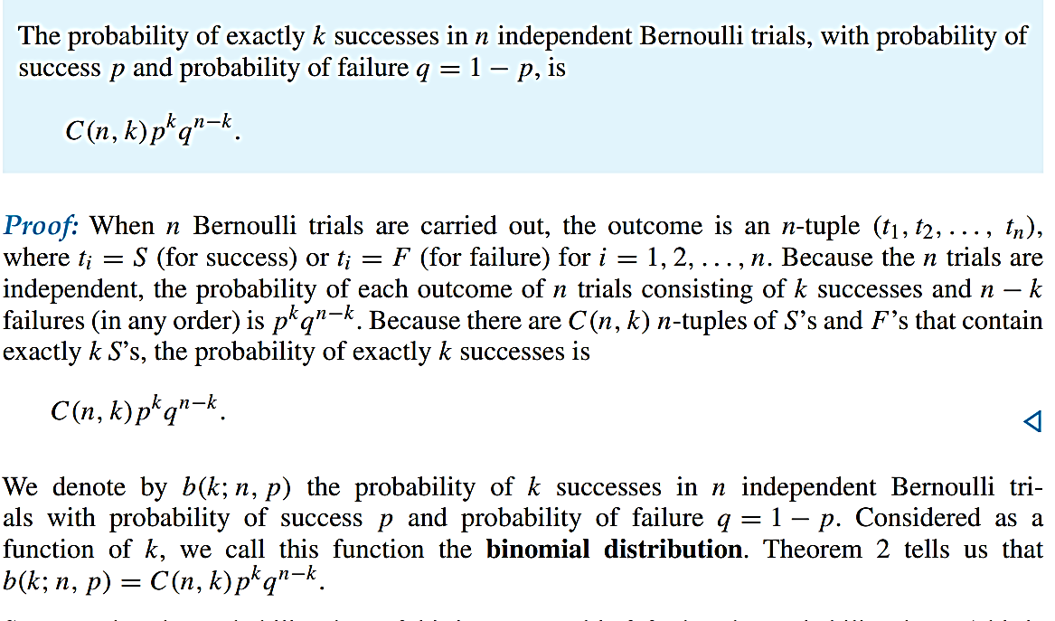
Bernoulli Trials and the Binomial Distribution
FREE: For Complete Playlist: https://www.youtube.com/c/FahadHussaintutorial/playlists
For Code, Slide and Books: https://fahadhussaincs.blogspot.com/

Slide 26
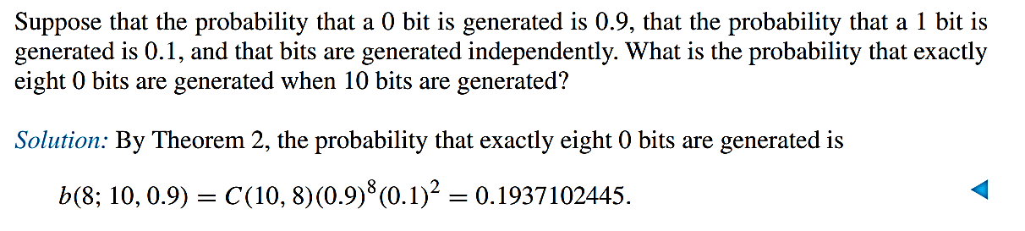
Bernoulli Trials and the Binomial Distribution
FREE: For Complete Playlist: https://www.youtube.com/c/FahadHussaintutorial/playlists
For Code, Slide and Books: https://fahadhussaincs.blogspot.com/

Slide 27
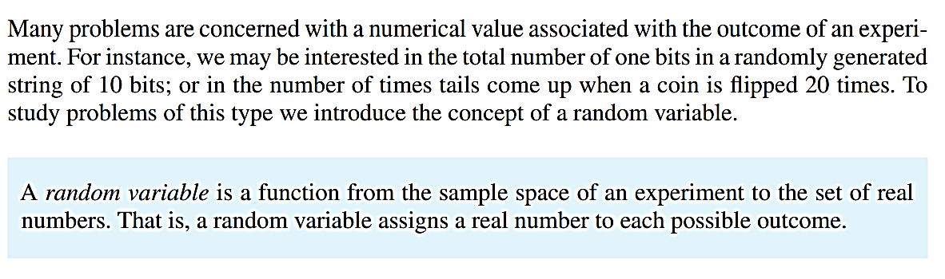
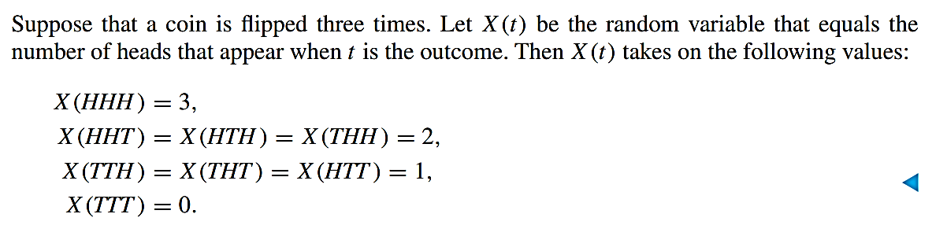
Random Variable
FREE: For Complete Playlist: https://www.youtube.com/c/FahadHussaintutorial/playlists
For Code, Slide and Books: https://fahadhussaincs.blogspot.com/

Slide 28
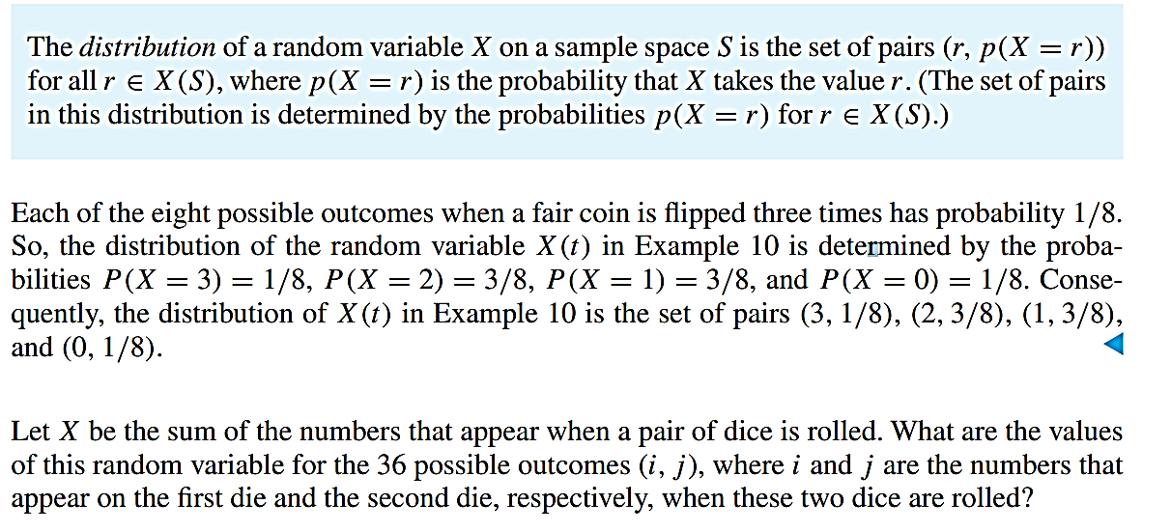
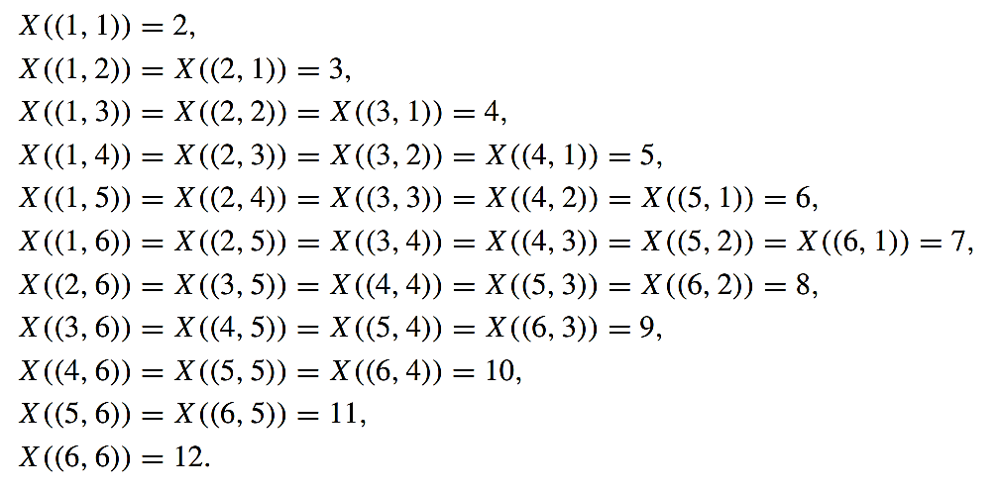

Slide 29
The Birthday Problem
In probability theory, the birthday problem asks for the probability that, in a set of n randomly chosen people, at least two will share a birthday. The birthday paradox refers to the counterintuitive fact that only 23 people are needed for that probability to exceed 50%.
What is the probability that out of 23 randomly chosen people at least two share a birthday?

Slide 30
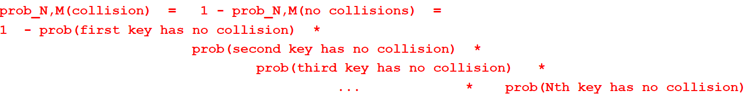
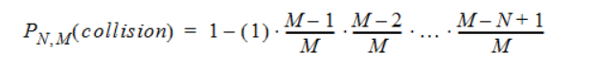
Probability of a Collision in Hashing Functions
What is the probability that no two keys are mapped to the same location by a hashing function, or, in other words, that there are no collisions?
Suppose you have a hash table with M slots, and you have N keys to randomly insert into it
What is the probability that there will be a collision among these keys?
You might think that as long as the table is less than half full, there is less than 50% chance of a collision, but this is not true
The probability of at least one collision among N random independently inserted keys is
The probability that a key will not collide with any of J keys already in the table is just the probability that it will land in one of the remaining M-J locations. If all locations are equally likely, then the probability of at least one collision when inserting N keys in a table of size M is:

Slide 31
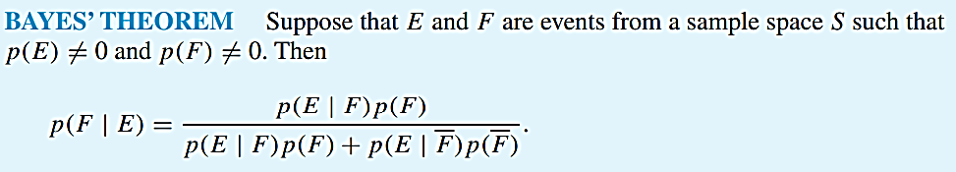
Chapter: 07 Discrete Probability
Monte Carlo Algorithms
7.3 Bayes’ Theorem
FREE: For Complete Playlist: https://www.youtube.com/c/FahadHussaintutorial/playlists
For Code, Slide and Books: https://fahadhussaincs.blogspot.com/

Slide 32
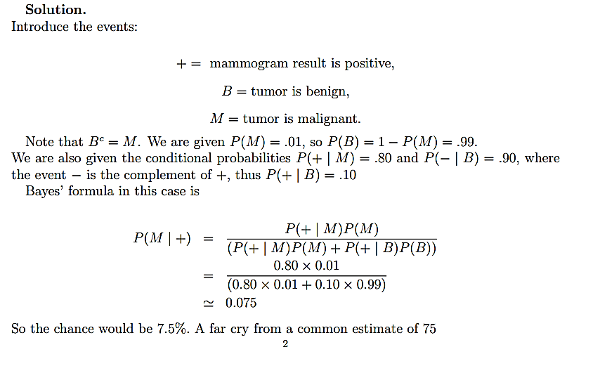
Chapter: 07 Discrete Probability
In a study, physicians were asked what the odds of breast cancer would be in a woman who was initially thought to have a 1% risk of cancer but who ended up with a positive mammogram result (a mammogram accurately classifies about 80% of cancerous tumors and 90% of benign tumors.) 95 out of a hundred physicians estimated the probability of cancer to be about 75%. Do you agree?

Slide 33
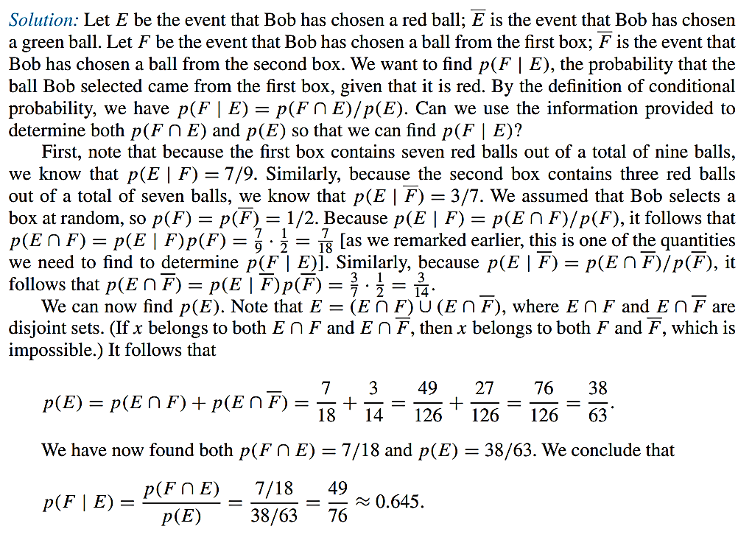
Chapter: 07 Discrete Probability
We have two boxes. The first contains two green balls and seven red balls; the second contains four green balls and three red balls. Bob selects a ball by first choosing one of the two boxes at random. He then selects one of the balls in this box at random. If Bob has selected a red ball, what is the probability that he selected a ball from the first box?

Slide 34
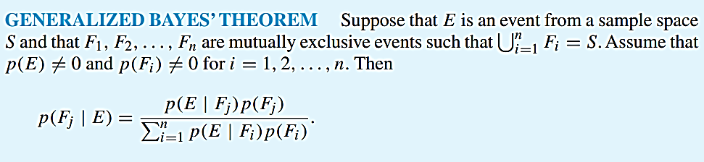
Chapter: 07 Discrete Probability
GENERALIZING BAYES’ THEOREM Note that in the statement of Bayes’ theorem, the events F and F are mutually exclusive and cover the entire sample space S (that is, F ∪ F = S). We can extend Bayes’theorem to any collection of mutually exclusive events that cover the entire sample space S, in the following way.
FREE: For Complete Playlist: https://www.youtube.com/c/FahadHussaintutorial/playlists
For Code, Slide and Books: https://fahadhussaincs.blogspot.com/

Slide 35
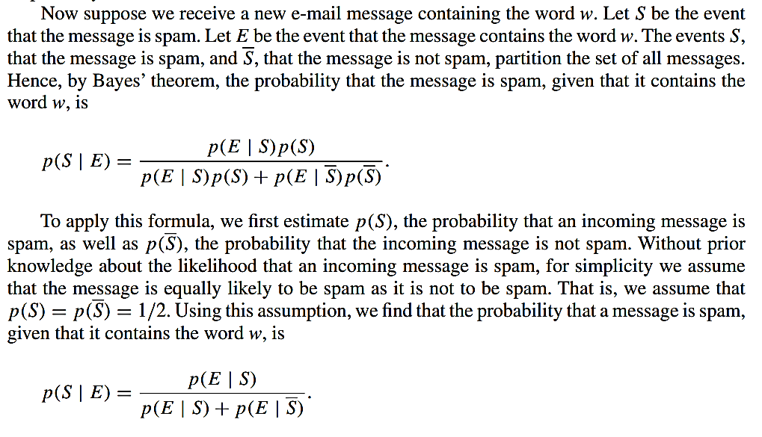
Bayesian Spam Filters
Most electronic mailboxes receive a flood of unwanted and unsolicited messages, known as spam. Because spam threatens to overwhelm electronic mail systems, a tremendous amount of work has been devoted to filtering it out. Some of the first tools developed for eliminating spam were based on Bayes’ theorem, such as Bayesian spam filters

Slide 36
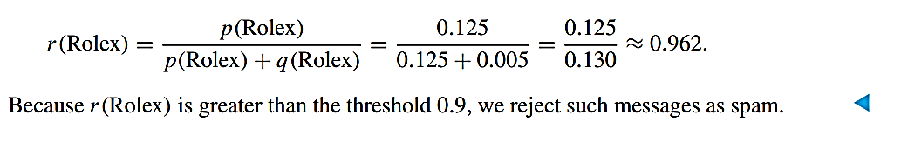
Chapter: 07 Discrete Probability
Bayesian Spam Filters
Suppose that we have found that the word “Rolex” occurs in 250 of 2000 messages known to be spam and in 5 of 1000 messages known not to be spam. Estimate the probability that an incoming message containing the word “Rolex” is spam, assuming that it is equally likely that an incoming message is spam or not spam. If our threshold for rejecting a message as spam is 0.9, will we reject such messages?
Solution: We use the counts that the word “Rolex” appears in spam messages and messages that are not spam to find that p(Rolex) = 250/2000 = 0.125 and q(Rolex) = 5/1000 = 0.005. Because we are assuming that it is equally likely for an incoming message to be spam as it is not to be spam, we can estimate the probability that an incoming message containing the word “Rolex” is spam by
FREE: For Complete Playlist: https://www.youtube.com/c/FahadHussaintutorial/playlists
For Code, Slide and Books: https://fahadhussaincs.blogspot.com/

Slide 37
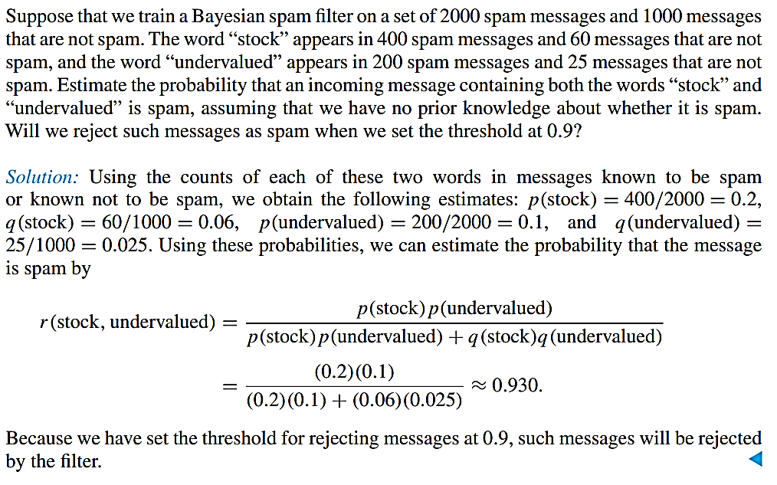
Chapter: 07 Discrete Probability
Bayesian Spam Filters

Slide 38
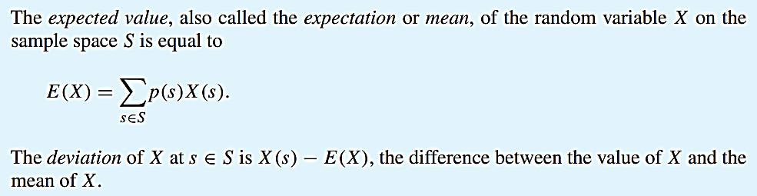
Chapter: 07 Discrete Probability
7.4 Expected Value and Variance
FREE: For Complete Playlist: https://www.youtube.com/c/FahadHussaintutorial/playlists
For Code, Slide and Books: https://fahadhussaincs.blogspot.com/

Slide 39

Chapter: 07 Discrete Probability
7.4 Expected Value and Variance

Slide 40

Chapter: 07 Discrete Probability
7.4 Expected Value and Variance
When an experiment has relatively few outcomes, we can compute the expected value of a random variable directly from its definition, as was done in Example 2. However, when an experiment has a large number of outcomes, it may be inconvenient to compute the expected value of a random variable directly from its definition. Instead, we can find the expected value of a random variable by grouping together all outcomes assigned the same value by the random variable, as Theorem 1 shows.
FREE: For Complete Playlist: https://www.youtube.com/c/FahadHussaintutorial/playlists
For Code, Slide and Books: https://fahadhussaincs.blogspot.com/

Slide 41

Chapter: 07 Discrete Probability
7.4 Expected Value and Variance

Slide 42

Chapter: 07 Discrete Probability
Linearity of Expectations

Slide 43

Chapter: 07 Discrete Probability
Linearity of Expectations
Problem: Given a fair dice with 6 faces, the dice is thrown n times, find the expected value of the sum of all results.
For example, if n = 2, there are total 36 possible outcomes.
(1, 1), (1, 2), .... (1, 6)
(2, 1), (2, 2), .... (2, 6)
................
................
(6, 1), (6, 2), ..... (6, 6)
Expected value of a discrete random variable is R defined as following. Suppose R can take value r1 with probability p1, value r2 with probability p2, and so on, up to value rk with probability pk. Then the expectation of this random variable R is defined as:

Slide 44

Chapter: 07 Discrete Probability
Linearity of Expectations
The above way to solve the problem becomes difficult when there are more dice throws.
If we know about the linearity of expectation, then we can quickly solve the above problem for any number of throws.
Linearity of Expectation: Let R1 and R2 be two discrete random variables on some probability space, then
FREE: For Complete Playlist: https://www.youtube.com/c/FahadHussaintutorial/playlists
For Code, Slide and Books: https://fahadhussaincs.blogspot.com/

Slide 45

Chapter: 07 Discrete Probability
Linearity of Expectations
Some interesting facts about Linearly of Expectation:
Linearity of expectation holds for both dependent and independent events. On the other hand the rule E[R₁R₂] = E[R₁]*E[R₂] is true only for independent events.
Linearity of expectation holds for any number of random variables on some probability space. Let R₁, R₂, R₃, … R_{k} be k random variables, then E[R₁ + R₂ + R₃ + … + R_{k}] = E[R₁] + E[R₂] + E[R₃] + … + E[R_{k}]

Slide 46

Chapter: 07 Discrete Probability
Linearity of Expectations
FREE: For Complete Playlist: https://www.youtube.com/c/FahadHussaintutorial/playlists
For Code, Slide and Books: https://fahadhussaincs.blogspot.com/

Slide 47

Chapter: 07 Discrete Probability
FREE: For Complete Playlist: https://www.youtube.com/c/FahadHussaintutorial/playlists
For Code, Slide and Books: https://fahadhussaincs.blogspot.com/

Slide 48


Geometric distribution
Geometric distribution is either one of two discrete probability distributions:
FREE: For Complete Playlist: https://www.youtube.com/c/FahadHussaintutorial/playlists
For Code, Slide and Books: https://fahadhussaincs.blogspot.com/

Slide 49

Chapter: 07 Discrete Probability
FREE: For Complete Playlist: https://www.youtube.com/c/FahadHussaintutorial/playlists
For Code, Slide and Books: https://fahadhussaincs.blogspot.com/

Slide 50

Chapter: 07 Discrete Probability
Independent Random Variables
We have already discussed independent events. We will now define what it means for two random variables to be independent.
An independent random variable is a random variable that doesn’t have an effect on the other random variables in your experiment. In other words, it doesn’t affect the probability of another event happening. For example, let’s say you wanted to know the average weight of a bag of sugar so you randomly sample 50 bags from various grocery stores. You wouldn’t expect the weight of one bag to affect another, so the variables are independent. The opposite is a dependent random variable, which does affect probabilities of other random variables.
FREE: For Complete Playlist: https://www.youtube.com/c/FahadHussaintutorial/playlists
For Code, Slide and Books: https://fahadhussaincs.blogspot.com/

Slide 51

Chapter: 07 Discrete Probability
How to Tell if Random Variables are Independent
You can tell if two random variables are independent by looking at their individual probabilities. If those probabilities don’t change when the events meet, then those variables are independent. Another way of saying this is that if the two variables are correlated, then they are not independent.
As a simple example, let’s say you have two random variables X and Y. X can equal 0, 1, or 2 and Y can equal 0 or 1. First, let’s take a look at their probabilities:
But what happens to the probabilities when the two happen at the same time?
For each possible combination of X, given that Y has happened (in notation, that’s (X|Y)), the probabilities are:
FREE: For Complete Playlist: https://www.youtube.com/c/FahadHussaintutorial/playlists
For Code, Slide and Books: https://fahadhussaincs.blogspot.com/

Slide 52

Chapter: 07 Discrete Probability
How to Tell if Random Variables are Independent
The changing y-values have no effect on the x probabilities. Assuming the reverse is also true (that changing x-values would have no effect on the y-values), these are independent random variables.
FREE: For Complete Playlist: https://www.youtube.com/c/FahadHussaintutorial/playlists
For Code, Slide and Books: https://fahadhussaincs.blogspot.com/

Slide 53

Chapter: 07 Discrete Probability
Variance
FREE: For Complete Playlist: https://www.youtube.com/c/FahadHussaintutorial/playlists
For Code, Slide and Books: https://fahadhussaincs.blogspot.com/

Slide 54


Chapter: 07 Discrete Probability
Variance
FREE: For Complete Playlist: https://www.youtube.com/c/FahadHussaintutorial/playlists
For Code, Slide and Books: https://fahadhussaincs.blogspot.com/

Slide 55

Chapter: 07 Discrete Probability
Variance
FREE: For Complete Playlist: https://www.youtube.com/c/FahadHussaintutorial/playlists
For Code, Slide and Books: https://fahadhussaincs.blogspot.com/

Slide 56

Chebyshev’s theorem and chebyshev’s Inequality
Chebyshev’s theorem is used to find the proportion of observations you would expect to find within a certain number of standard deviations from the mean. Chebyshev’s Interval refers to the intervals you want to find when using the theorem. For example, your interval might be from -2 to 2 standard deviations from the mean.
For normal distributions, about 68% of results will fall between +1 and -1 standard deviations from the mean. About 95% will fall between +2 and -2 standard deviations. The Theorem allows you to use this idea for any distribution, even if that distribution isn’t normal. The theorem states:
For a population or sample, the proportion of observations is no less than (1 – (1 / k2 ))
FREE: For Complete Playlist: https://www.youtube.com/c/FahadHussaintutorial/playlists
For Code, Slide and Books: https://fahadhussaincs.blogspot.com/

Slide 57

Chapter: 07 Discrete Probability
FREE: For Complete Playlist: https://www.youtube.com/c/FahadHussaintutorial/playlists
For Code, Slide and Books: https://fahadhussaincs.blogspot.com/

Slide 58

Chapter: 07 Discrete Probability

